Slide 1

Modelling the Cost of Waste Disposal
Ali Hosseinifar
Matricola: 5646928
RESOURCE AND ENVIRONMENTAL ECONOMICS

Slide 2
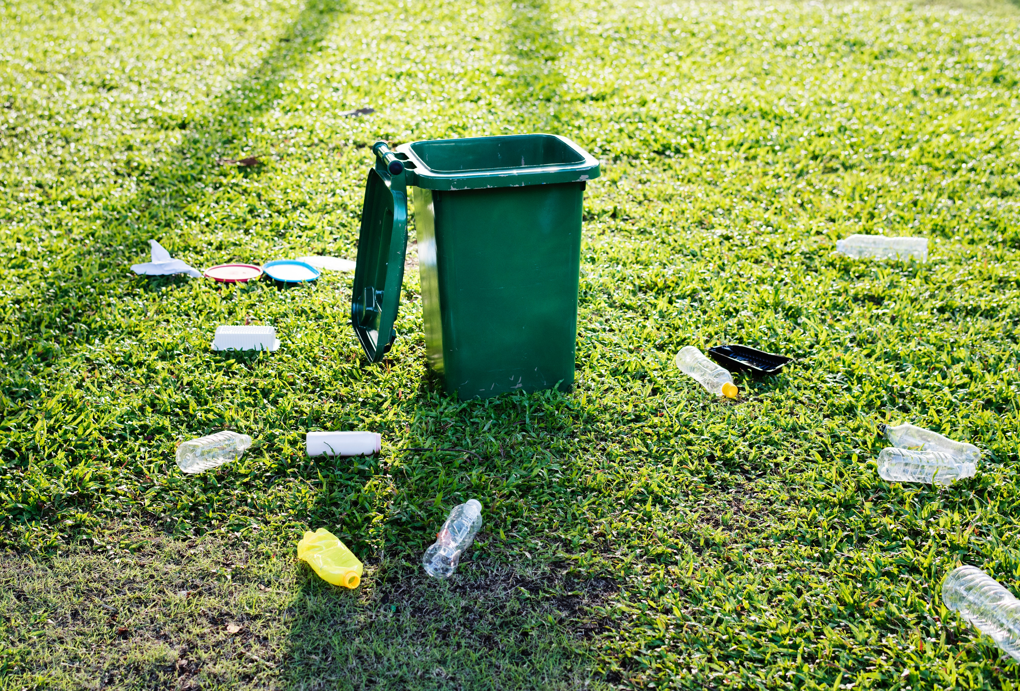
Introduction
Importance of Waste Management:
Rising waste generation poses environmental and health risks.
Efficient practices, like recycling, reduce impact and protect public health.
Vital for ensuring a sustainable and healthy future.

Slide 3
Data Overview Dataset 1: Regional Averages of Specific Costs per Capita
The key features include:
Region, Perc. RD (%), Per Capita RU (kg/inhabitant).
Detailed Cost Breakdown: CRTab, CTSab, CRDab, CTRab, CSLab, CCab, CKab, Other costs, Total Cost per Capita (CTOTab).
CRTab: Collection and transportation costs of undifferentiated urban waste.
CTSab: Treatment and disposal costs of undifferentiated urban waste.
CRDab: Collection and transportation costs of differentiated urban waste.
CTRab: Treatment and recycling costs of differentiated urban waste.
CSLab: Street sweeping and cleaning costs.
CCab: Common costs.
CKab: Capital remuneration costs.
Total Cost per Capita (CTOTab): The overall cost of managing the urban hygiene service per inhabitant.

Slide 4
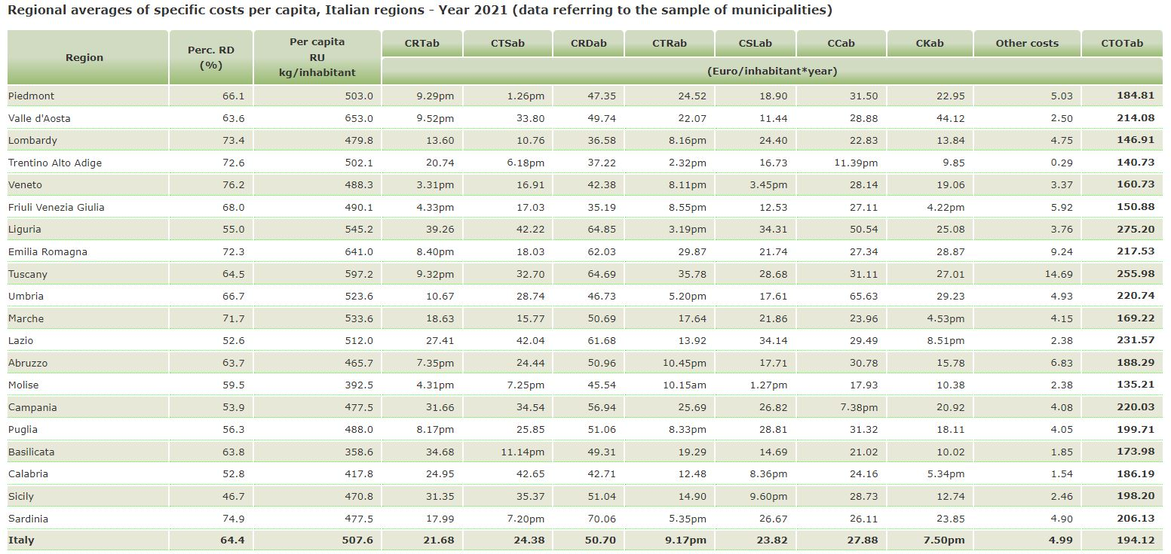
Regional Averages of Specific Costs per Capita

Slide 5
Dataset 2: National Production » Regional Production
Key Features
Region
ISTAT Code
Population
Separate Waste Collection (t)
Municipal Waste (t)
RD (%) and RD Per Capita (kg/inhabitant/year)

Slide 6
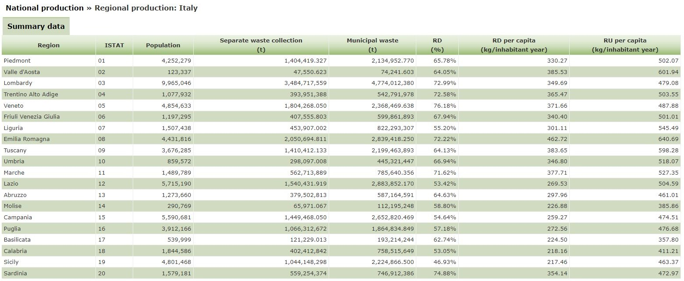
National Production » Regional Production

Slide 7
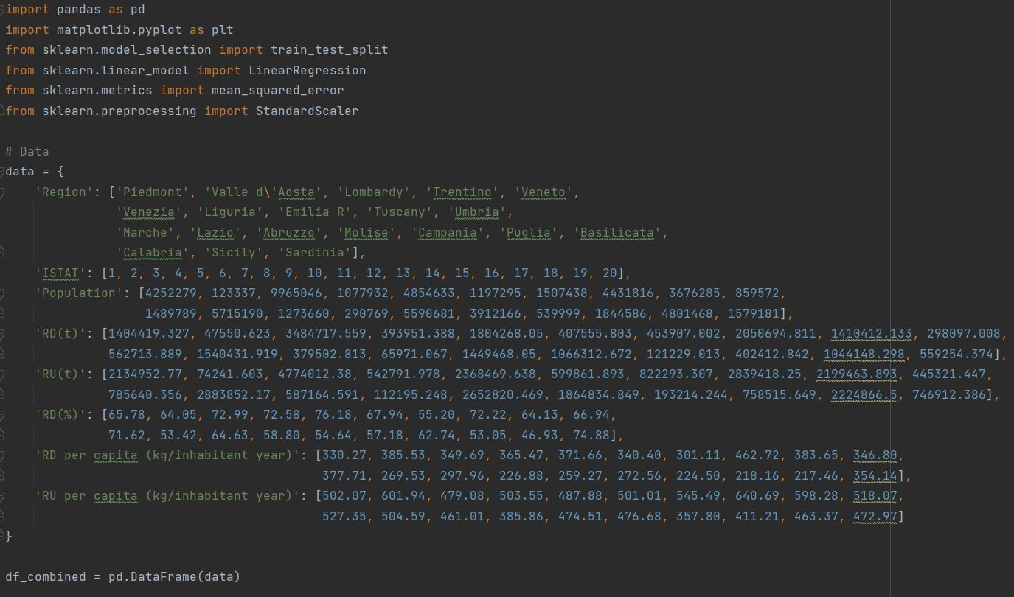
Exploratory Data Analysis (EDA)

Slide 8

Data Analysis MSW Generation Analysis
Total Waste Calculation:
Quantifies municipal solid waste from residential, commercial, and industrial sources.
Recycling Rate Analysis:
Gauges success in sustainability and identifies opportunities for a circular economy.
Per Capita Waste Analysis:
Measures individual contributions to waste generation for tailored strategies.

Slide 9
Linear Regression Model
Model Features:
Population: The total population of each region.
RD % (Recyclable Waste Percentage): The percentage of waste that is recyclable.
RU Per Capita (kg/inhabitant year): The amount of recyclable waste generated per capita.
We are using a Linear Regression model to understand how population, the percentage of recyclable waste (RD %), and the amount of recyclable waste generated per capita (RU Per Capita) contribute to the total waste generation. These features help us predict the Total Waste per region, providing insights into waste generation patterns.

Slide 10
Model Evaluation
Linear Regression Model Performance
Training RMSE (Root Mean Squared Error)
Test RMSE (Root Mean Squared Error)
# Model Evaluation train_rmse_combined = mean_squared_error(y_train_combined, y_pred_train_combined, squared=False) test_rmse_combined = mean_squared_error(y_test_combined, y_pred_test_combined, squared=False)
We evaluate the performance of our Linear Regression model using Root Mean Squared Error (RMSE). RMSE measures the average prediction error, providing an indication of how well the model performs on both the training and test datasets. Lower RMSE values indicate better model accuracy. In our survey we have:
Train RMSE (scaled features): 0.11
Test RMSE (scaled features): 0.12

Slide 11
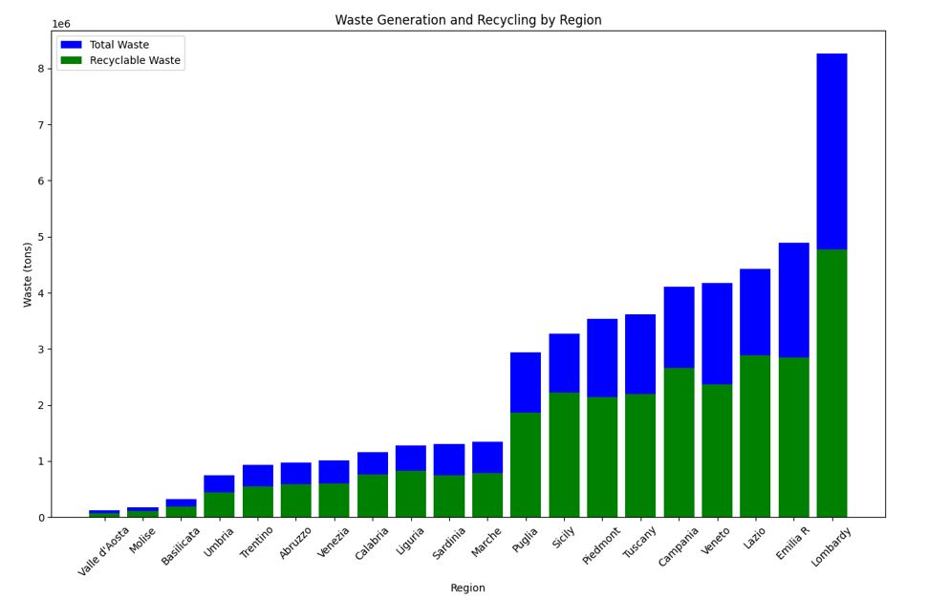
Visualization Of Model
The visualization includes bar charts illustrating the waste generation and recycling by region, as well as the cost distribution by region.
Waste Generation and Recycling by Region: Bar chart showcasing total waste and recyclable waste by region
Visualization Explanation
The blue bars represent the total waste generated by each region.
The green bars represent the recyclable waste within the total waste.
This visualization helps in understanding the distribution of waste generation and the proportion that is recyclable.

Slide 12
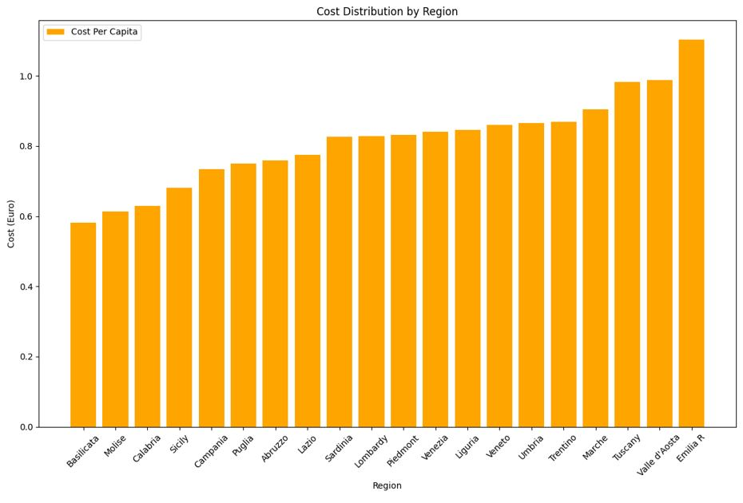
Visualization Of Model
Cost Distribution by Region: Bar chart showcasing cost per capita by region
Visualization Explanation
The orange bars represent the cost per capita associated with waste disposal in each region.
This visualization provides insights into the economic aspects of waste management, indicating regions with higher or lower costs per capita.

Slide 13
Waste Generation and Recycling by Region and Cost Distribution by Region
Observations:
Lombardy and Emilia Romagna exhibit the highest total waste generation, emphasizing their significant contributions to the overall waste output.
Valle d'Aosta and Molise, on the other hand, demonstrate lower total waste generation, indicating a potential focus on waste reduction strategies in these regions.
Observations:
Emilia Romagna stands out with the highest cost per capita, underscoring the economic investment in waste management in this region.
Valle d'Aosta, despite its low waste generation, exhibits a higher cost per capita, suggesting unique challenges or specialized waste disposal methods.
Regions such as Basilicata and Molise show lower costs per capita, indicating potential efficiencies or differences in waste management practices.

Slide 14
Regional Waste Management Strategies
Strengthen Waste Reduction:
Implement robust programs, focusing on high-generation regions.
Cross-Regional Collaboration:
Foster knowledge-sharing on successful models, particularly from Valle d'Aosta and Molise.
Evaluate High-Cost Investments:
Assess impacts of comprehensive waste management, especially in regions like Emilia Romagna.

Slide 15
Potential Changes and Improvements
Targeted Approaches for Challenges: Develop policies addressing unique challenges in high-cost regions like Valle d'Aosta.
Replicate Cost-Efficient Practices: Implement observed efficient waste management practices from lower-cost regions.
Regional Cost Optimization: Analyze factors influencing expenses in specific regions for targeted improvements.
Robust Monitoring: Implement effective monitoring for continuous improvement, considering regional nuances.
Public Awareness Campaigns: Launch comprehensive campaigns tailored to regional needs for responsible waste disposal.

